Slide 1
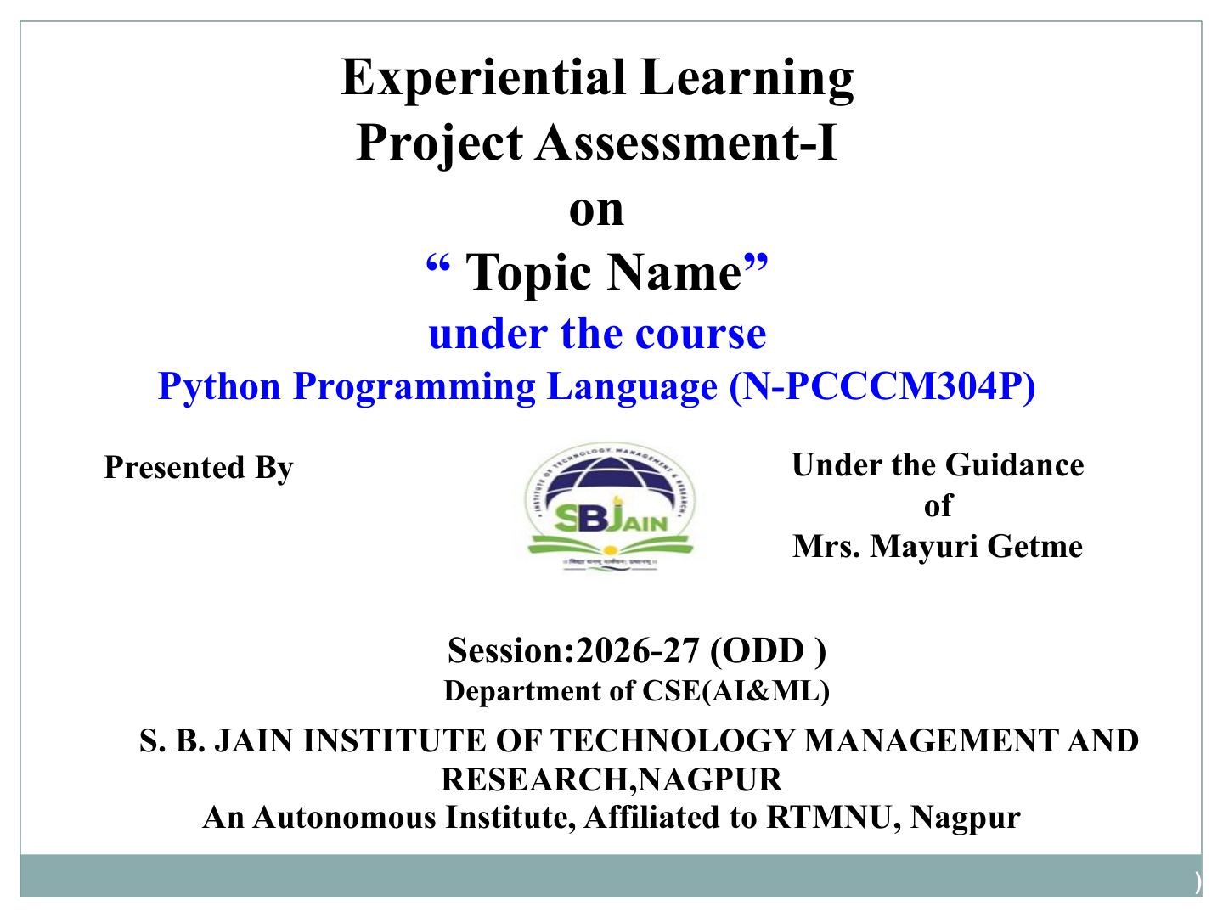
“Balanced Parenthesis Checker”
Yash Petkar
S. B. Jain Institute of Technology Management and research

Slide 2

Problem Statement
THE PROBLEM
Develop a Python-based application that checks whether an expression contains properly balanced parentheses, brackets and braces.
(
→
)
[
→
]
{
→
}
Parentheses
Brackets
Braces
Mathematical expressions + code snippets • correct nesting • clear result
S. B. Jain Institute of Technology Management and research

Slide 3
Objectives
01
MATCH
02
ORDER
Verify (), [] and {} pairs.
Check correct nesting order.
03
STACK
04
DETECT
Use LIFO stack logic.
Find mismatches & missing symbols.
05
RESULT
06
LEARN
Return Balanced / Not Balanced.
Apply Python lists, loops & conditions.
S. B. Jain Institute of Technology Management and research

Slide 4
Algorithm
1
Read the expression from the user.
2
Create an empty stack list.
3
Create a pairs dictionary for ), ] and }.
4
Scan the expression one character at a time.
5
If the character is (, [ or {, push it into the stack.
6
If the character is a closing symbol, check whether the stack is empty.
7
Compare the top of stack with pairs[character]. If it does not match, return False.
8
If it matches, pop the top element. After the loop, empty stack = Balanced; otherwise Not Balanced.
S. B. Jain Institute of Technology Management and research

Slide 5
Flowchart / Pseudocode
START
Input expression
Read next character
Opening symbol?
Push to stack
YES
YES
Closing symbol?
Pop & compare
Mismatch → False
NO
More characters?
Stack empty → True
YES
S. B. Jain Institute of Technology Management and research

Slide 6
Understanding of Python Logic
stack = []
Creates an empty list used as a stack.
stack.append(ch)
Pushes an opening bracket onto the stack.
stack.pop()
Removes the latest opening bracket (LIFO).
if len(stack) == 0
Detects a closing bracket without an opening bracket.
top != matching symbol
Detects incorrect nesting/order.
return len(stack) == 0
Final check: all opening symbols were matched.
S. B. Jain Institute of Technology Management and research

Slide 7
Python Code Implementation
def is_balanced(expression):
stack = []
pairs = {
')': '(',
']': '[',
'}': '{'
}
for char in expression:
if char in '([{':
stack.append(char)
elif char in ')]}':
if not stack:
return False
if stack[-1] != pairs[char]:
return False
stack.pop()
return len(stack) == 0
expression = input("Enter an expression: ")
if is_balanced(expression):
print("Balanced Parentheses")
else:
print("Not Balanced Parentheses")
S. B. Jain Institute of Technology Management and research

Slide 8
Sample Input / Output & Stack Working
{[()]}
Balanced Parentheses
{[(])}
Not Balanced Parentheses
(a+b) * [c-d]
Balanced Parentheses
((a+b)
Not Balanced Parentheses
Example of LIFO stack processing:
{
[
(
)
]
}
S. B. Jain Institute of Technology Management and research

Slide 9
Test Results & Complexity Analysis
Sample Test Set Results
Complexity
Time Complexity: O(n)
Each character is processed once.
3
3
Space Complexity: O(n)
Stack can hold opening symbols.
Core DSA Concept: Stack
Balanced
Not Balanced
LIFO — Last In, First Out
S. B. Jain Institute of Technology Management and research

Slide 10
GitHub, Repository & Individual Contribution
Github username :- ritikprtkar44
Github reponame:- Python Programming
01
REPOSITORY
02
UPLOAD
Project repository created on GitHub.
Python code + documentation.
03
COMMITS
04
COLLABORATE
Clear messages for every major change.
Review, test and improve together.
MEANINGFUL COMMITS
“Implement stack checker” • “Add test cases” • “Update documentation”
S. B. Jain Institute of Technology Management and research

Slide 11
